Slide 1
Fundamentals of deep learning for multi-gpus lab 3, part 2: optimization strategies

Slide 2
What can we do to improve the optimization process?
Manipulate the learning rate?
Add noise to the gradient?
Manipulate the batch size?
Change the learning algorithm?
Notes:
Noise in the gradient update makes the sharp minima unstable.

Slide 3
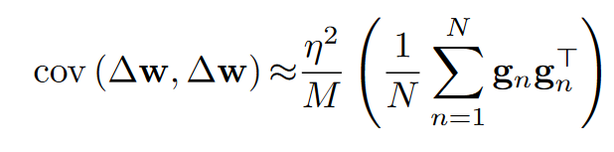
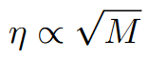
What can we do about it?
Early approaches: scaling the learning rate
“Theory suggests that when multiplying the batch size by k, one should multiply the learning rate by √(k) to keep the variance in the gradient expectation constant.
...
Theory aside, for the batch sizes considered in this note, the heuristic that I found to work the best was to multiply the learning rate by k when multiplying the batch size by k. I can’t explain this discrepancy between theory and practice.”
In practice linear scaling is still frequently used.
Krizhevsky, A. (2014). One weird trick for parallelizing convolutional neural networks. arXiv:1404.5997

Slide 4
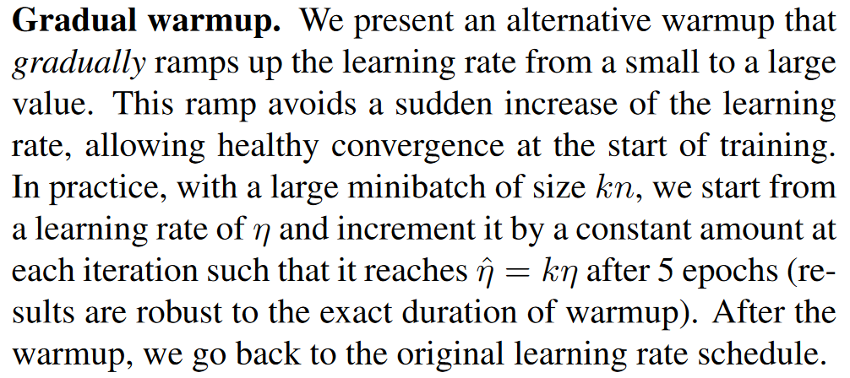
What can we do about it?
Warmup strategies
A lot of networks will diverge early in the learning process
Warmup strategies address this challenge
Goyal, P., Dollár, P., Girshick, R., Noordhuis, P., Wesolowski, L., Kyrola, A., ... & He, K. (2017). Accurate, Large Minibatch SGD: Training ImageNet in 1 Hour. arXiv:1706.02677
Notes:
Noise in the gradient update makes the sharp minima unstable.

Slide 5
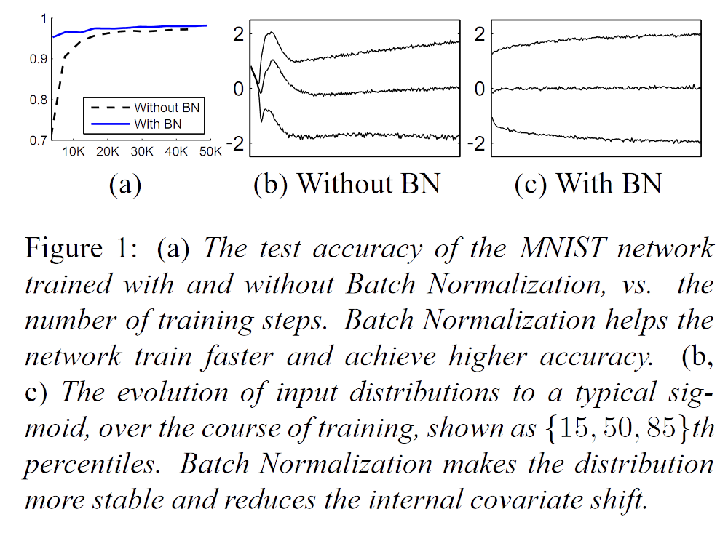
What can we do about it?
Batch Normalization
Batch normalization improves the learning process by minimizing drift in the distribution of inputs to a layer
It allows higher learning rates and reduces the need to use dropout
The idea is to normalize the inputs to all layers in every batch (this is more sophisticated than simply normalizing the input dataset)
Ioffe and Szegedy (2015). Batch Normalization: Accelerating Deep Network Training by Reducing Internal Covariate Shift. arXiv:1502.03167

Slide 6
What can we do about it?
Ghost Batch Normalization
The original batch normalization paper suggests using the statistics for the entire batch, but what should that mean when we have multiple GPUs?
We can introduce additional noise by calculating smaller batch statistics (“ghost batches”).
Batch normalization is thus carried out in isolation on a per-GPU basis.
Hoffer, E., Hubara, I., & Soudry, D. (2017). Train longer, generalize better: closing the generalization gap in large batch training of neural networks. arXiv:1705.08741
Notes:
Noise in the gradient update makes the sharp minima unstable.

Slide 7
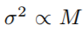
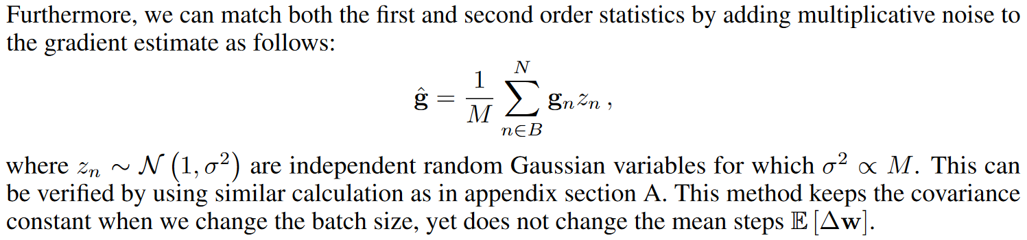
What can we do about it?
Adding noise to the gradient
Keeps the covariance constant with changing batch size (as )
Does not change the mean
Hoffer, E., Hubara, I., & Soudry, D. (2017). Train longer, generalize better: closing the generalization gap in large batch training of neural networks. arXiv:1705.08741
Notes:
Noise in the gradient update makes the sharp minima unstable.

Slide 8
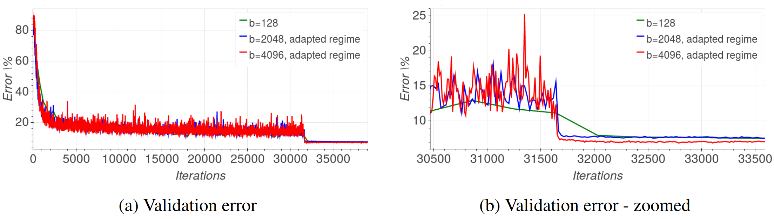
What can we do about it?
Longer training with larger learning rate
Hoffer, E., Hubara, I., & Soudry, D. (2017). Train longer, generalize better: closing the generalization gap in large batch training of neural networks. arXiv:1705.08741
Notes:
Noise in the gradient update makes the sharp minima unstable.

Slide 9
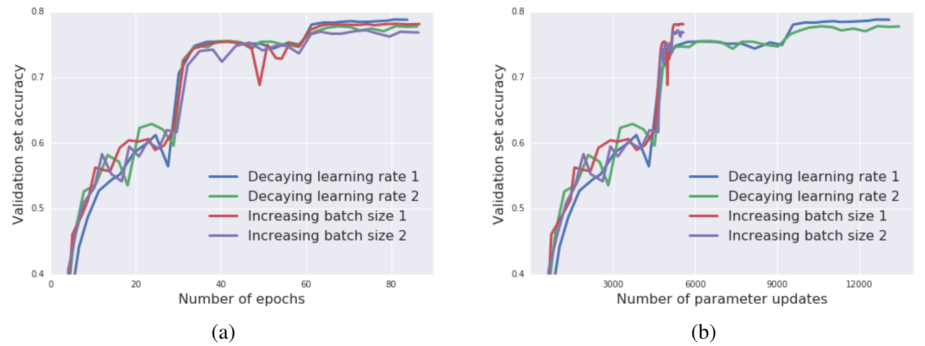
What can we do about it?
Increasing the batch size, instead of learning rate decay
Smith, S. L., Kindermans, P. J., & Le, Q. V. (2017). Don't Decay the Learning Rate, Increase the Batch Size. arXiv:1711.00489
Notes:
Noise in the gradient update makes the sharp minima unstable.

Slide 10
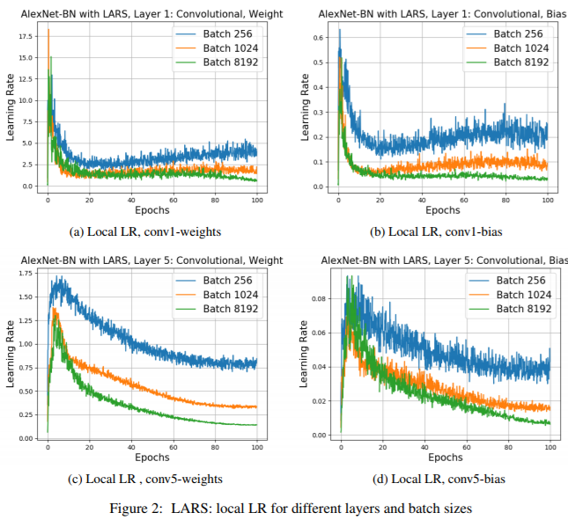
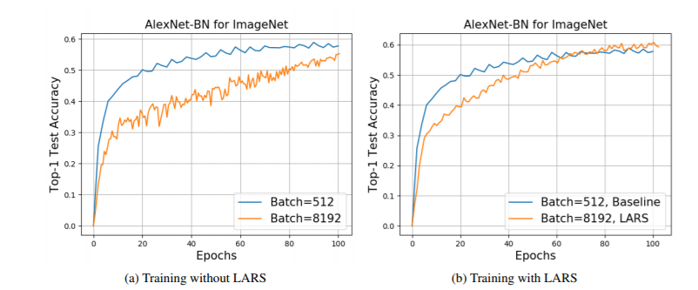
What can we do about it?
LARS: Layer-wise Adaptive Rate Scaling
You, Y., Gitman, I., & Ginsburg, B. Large batch training of convolutional networks. arXiv:1708.03888
Notes:
Every layer gets its own learning rate.

Slide 11
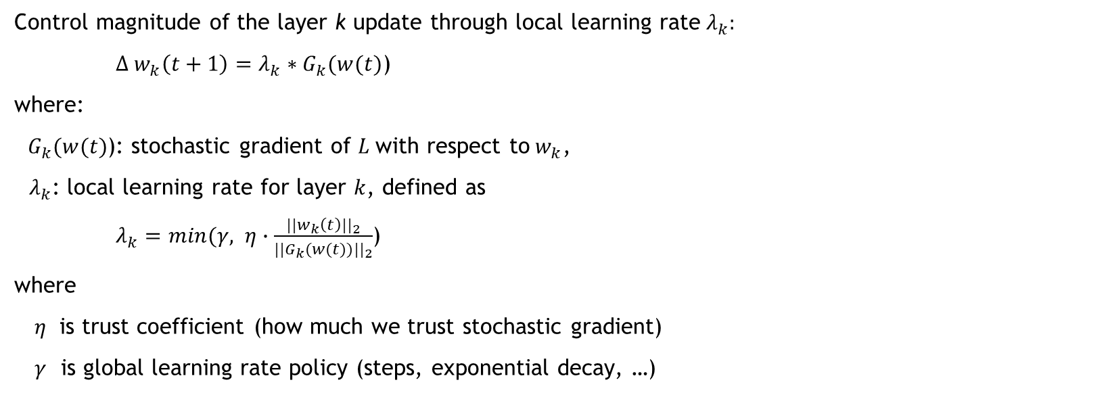
What can we do about it?
LARS: Layer-wise Adaptive Rate Scaling
Control magnitude of the layer k update through local learning rate${ λ}_{k}:$
$∆ w_{k}\left(t+1\right)=λ_{k}∗G_{k}(w(t)$)
where:
$G_{k}(w(t)$): stochastic gradient of $L$with respect to${ w}_{k}$,
$λ_{k}$: local learning rate for layer $k$, defined as
$λ_{k}=min(γ, η∙\frac{{||w_{k}\left(t\right)||}_{2}}{{||G_{k}(w(t))||}_{2}}$)
where
$η$ is trust coefficient (how much we trust stochastic gradient)
$γ$ is global learning rate policy (steps, exponential decay, …)
You, Y., Gitman, I., & Ginsburg, B. Large batch training of convolutional networks. arXiv:1708.03888
Notes:
Every layer gets its own learning rate.

Slide 12
What can we do about it?
LARC: Layer-wise learning rates with clipping; SGD with momentum is base optimizer
LAMB: Layer-wise learning rates; Adam as base optimizer
More successful than LARC at language models like BERT
NovoGrad: Moving averages calculated on a per-layer basis
Also useful in several different domains

